Slide 1
21ECE324T-ADVANCED MOBILE COMMUNICATION SYSTEMS
Unit-5
Security Services and Applications

Slide 2
Syllabus
Security Threats and Challenges
Security Implications in 5G Environments and Use Cases
Security Layers
Device Security
Security between Network Entities
Vehicle Communications
Machine Learning and Artificial Intelligence

Slide 3
5G Security Threats and Challenges

Slide 4
5G Security Threats and Challenges
Overall Internet development is leading the way to virtualization of practically all the communications of key businesses such as banking and governance.
Along with easing that aspect of life, the Internet has demonstrated the vulnerability of the societies when relying completely on the virtualization.
5G is not designed only for consumer markets but is planned to support remarkable volumes of IoT traffic via mIoT use cases, i.e. massive Internet of Things.
There is thus a special emphasis on the security aspects of 5G.
Enhancing further the performance under attacks such as DDoS (distributed denial of service) or MITM (man in the middle)

Slide 5
Trends
One of the documents summarizing the latest trends on the Internet and mobile communications environments is the annual Verizon Data Breach Investigations Report
The report divides the data incident patterns into categories: insider and privilege misuse (access via trusted actors), cyber-espionage (targeted external attacks), web application attacks (stolen credentials and vulnerability exploits), crimeware (malware incidents), point-of-sale intrusions (POS attacks aiming to payment card data disclosure), denial of service attacks (DoS or distributed DoS aiming to affect business operations), payment card skimmers (tampering of ATMs and terminals), physical theft (loss of IT data), and miscellaneous errors (causing data loss).
As for the mobile communications point of view, the main categories of this report are related to crimeware, DoS and web attacks, although there are various other categories that can indirectly impact on the security via mobile communications systems, such as exploiting the weaknesses of payment via near-field communications (NFCs).

Slide 6
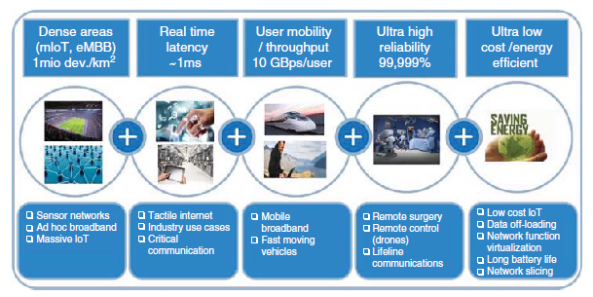
5G targets and use cases.

Slide 7
Needs in Mobile Environment
the key aspects of the up-to-date 5G security architecture:
New and already existing service and device deployment scenarios for mIoT
Energy efficiency, especially for battery driven devices
Compatibility with ultra-low latency requirements
New technical concepts such as network slicing and virtualization
Enhanced user data integrity
Enhanced user privacy
Different types of access networks ranging from licensed to unlicensed spectrums
Public vs. private networks, i.e. open vs. closed networks

Slide 8
Network Slicing
Protection of the interfaces of network slices and functions for internetwork slice communication
Prevention of impersonation attacks against the network slice selection function
Prevention of impersonation attacks against the network slice instance
Assurance of adequate mechanisms to provide sufficient protection if different security protocols or policies are applied in different network slices
Protection against DoS through exhausting resources that are common to multiple slices within one slice
Prevention of side channel attacks and timing attacks across slices when several slices share the same underlying hardware
Consideration of hybrid deployment models, i.e. a mixture of virtualized and non-virtualized network functions
Provisioning of security mechanisms within the network or potentially within the UE to enable sealing between slices when the UE is attached to several slices

Slide 9
Network Virtualization
Virtualization must not cause new security threats, e.g. caused by vulnerabilities of the hypervisor.
(Common) network functions and hardware resources such as storage and networking are connected throughout different virtual NFs.
There is interconnectivity between network functions virtualization (NFV) components.
Isolation of virtual network functions (VNFs) are used over the NFV infrastructure.
Performance − it is likely that VNFs may have less per-instance capacity compared to physical NFs. Therefore, mechanisms are needed that split the workload between multiple instances of the VNF.

Slide 10
Edge Computing
Routing significant data directly between the UE and the network edge without involving the core network and, in roaming, without reaching the home network implies that the charging records transmitted by the edge component have to be reliable and secured. Considering that the edges of the network are more vulnerable to attacks the risk of billing errors is potentially significant.
Edge computing applications run on the same hardware as NFs do. As edge computing applications may not be owned and controlled by the operator, a relationship between those entities (operator and third-party application provider)must be established that guarantees that the third-party application does not harm the operator NFs.
It is intended that applications influence the performance of the network automatically. It means that in case the applications require more bandwidth, the NF at the edge is configured automatically so that the demanding application gets more bandwidth. This may lead to reduced performance and throughput for other applications if the demanding application consumes too much bandwidth either accidentally or maliciously.
Delivering content directly from the edge to the UE implies that replicas of the content are available within the edges in a cashed form. Accessing this content means that Internet Protocol (IP) communication terminates and that IP protocols have their endpoints in the edge.
Storage of sensitive security assets at the edge need to be protected to avoid compromising them. In addition, those assets need to be protected when being exchanged between the network core and the mobile edge.

Slide 11
Open Source
Introducing standard IP means that network infrastructure that has previously been protected through “security by obscurity” and proprietary mechanisms is now subject to a much larger attack community. It is expected that this also opens new attack vectors.
All successful attacks on IPs now also automatically affect the 5G infrastructure

Slide 12
Other 5G Safety Considerations
Quantum-safe computing. As 5G is supposed to be used during the next 20 and more years, quantum computing may develop into the next levels, jeopardizing all the previous security measures. Specifically, quantum computing may allow breaking asymmetric crypto algorithms that are considered future-proofed still up today. New asymmetric algorithms may be needed to overcome this threat. In addition, symmetric algorithms are regarded as quantum-safe. However, it may be required to extend the length of the keys.
Physical layer security. Today, security takes place above the physical layers. For a second phase of 5G (e.g. when using the new spectrum) physical layer security may have to be considered. Through this means, low latency and high performance could be achieved when those mechanisms are implemented in the physical layer. Some concepts exist and are being discussed in the research community.
mmWave. A technology that is required to provide a new spectrum in the higher frequency bands, above 6 GHz. In addition to the reallocation of existing spectrum to 5G (e.g. 700MHzfor mIoT and 3.4–3.8 GHz for enhanced Mobile Broadband [eMBB] and vehicle-to-everything [V2X]), new spectrum such as 28 GHz in the United States and Korea is allocated and required to achieve indoor penetration, high bandwidth, and low latency. Europe prefers 25 GHz and/or 32 GHz. It is important to harmonize the frequencies globally and to make sure synergies can be achieved by selecting frequencies so that they can be filtered and adapted (possible within a range of 4–5 GHz). This is important for devices but also for infrastructure components.

Slide 13
Development
1. LTE Evolution
Many operators are currently investing in LTE. It is likely that 4G-LTE will continue to grow and advance to address some of the use cases that are listed for 5G.
2. NB-IoT vs. Low-PowerWide Area
It is expected that 5G mIoT will replace NB-IoT later as 5G achieves additional cost advantages due to virtualization and network slicing.
3. Ramping Up 5G
the network slicing may be introduced at a later phase of 5G to speed up the initial deployments. From a security point of view, it means that the MNOs will not be able to provide the level of isolation as can be achieved with network slicing and NFV.

Slide 14
Security Implications in 5G Environments and Use Cases

Slide 15
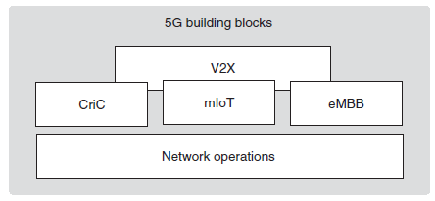
Security Implications in 5G Environments and Use Cases
To facilitate and simplify the discussion, the 3GPP has split 5G into four building blocks. They are the basis for the definition of requirements, use case groups and common characteristics. The 3GPP building blocks are:
1. Network operations (NEO), defining the NEO use cases and building basis for the
other building blocks
2. Enhanced Mobile Broadband (eMBB), defining high bandwidth and user mobility as well as broadband everywhere use cases
3. Massive Internet of Things (mIoT), addressing the low-power, wide-area range of use cases
4. Critical communications (CriC) for low latency and high reliability use cases (Please note that V2X communication could be considered as a fifth building block or as a combination of the other blocks.)
Fig. 5G building blocks as defined by 3GPP

Slide 16
Network Operations
The main target of the MNOs is to build the 5G networks in a flexible manner to support diverse scenario demands, The following security requirements need to be covered:
Confidentiality and integrity protection of voice, data, and signaling
Authorization, confidentiality, and integrity protection between network elements and networks
Authorization, confidentiality, and integrity protection for next generation services
Authorization for users, devices, and networks
Extensible systems for new algorithms and procedures to mitigate risks e.g. coming from quantum computing
Prevention against DoS and signaling attacks
Privacy protection, e.g. by means of pseudonyms or temporary identifiers and by protection user location information
Support emergency cases i.e. granting temporary access to the network based on operator policies
Device theft prevention: supporting a secure mechanism to disable or re-enable a stolen device; protecting device identifiers when being stored

Slide 17
Network Operations
With regards to the new technologies and concepts introduced with 5G this requires the security solution to consider the following topics:
Service specific security as realized by a network slice must be supported. Those security configurations are well isolated within the network by the means of those slices. Slice-specific security includes the capability to leave it up to third parties to configure the security of that slice, e.g. by suitable application programming interfaces (APIs) to a certain extent (as defined by the network operator).
The 5G system shall support a secure mechanism to collect system information while ensuring end-user and application privacy. For example, application level information such as application usage information is not to be related to an individual application user identity or subscriber identity and UE level information, such as UE location is not to be related to an individual subscriber identity.
LI requirements need to be fulfilled. That also covers content that may be cached e.g. at the edge of the network.
Many ways to access the network shall be supported. This includes the case where a device accesses the 5G network through a different radio access technology (Wi-Fi) and authenticates using its 5G credentials.

Slide 18
Enhanced Mobile Broadband
The eMBB is a natural evolution of LTE and LTE-Advanced. The following security capabilities need to be considered:
Content protection. The content is valuable and must be sent to authorized and authenticated users only. The content may also need to be protected by encrypting it both on the network layer (via encryption and integrity protection on the radio interface) and the service layer (DRM service). In addition, content may be broadcasted to several devices.
As users are moving indoor, outdoor, or between indoor and outdoor, the authentication mechanism need to support a seamless user experience. This means the connection must remain stable with no interruption even when moving from Wi-Fi (indoor) to the 5G network (outdoor), thus not requiring a reestablishment of the session because of re-authentication. 3GPP indoor and outdoor usage and handover must be supported between the two networks.
Privacy is important. Users do not want others to determine which data they consumed when and where.
Strong mutual authentication and user identification is required. This enables charging/ billing.
Fixed and mobile convergence must be considered. Some fixed-line services may be replaced by mobile services to address the last mile to the customer. In that case, the overall security over fixed broadband shall be the same as for the 5G mobile broadband access link.

Slide 19
Massive Internet of Things
The following security capabilities in mIoT security need to be considered:
Data represents the asset in mIoT. Therefore, it is necessary to prevent unauthorized manipulation of that data and to thus ensure data integrity. A separation of the application security from the network access security is in particular relevant in IoT as in many IoT scenario the value of the application data may be more significant compared to the value of the single connectivity.
Data need to be confidentiality-protected. This is for privacy reasons and to prevent misuse.
For battery-powered devices, security protocols and mechanism need to be energy-efficient. They must also provide high security while optimizing the overhead, e.g. by reducing re-authentication intervals.
Security expenses must be kept to a minimum. As the cost of such a considerable number of devices need to be low, the extra expense resulting from the respective security mechanisms need to be reduced to an absolute minimum.

Slide 20
Massive Internet of Things
mIoT devices may access the network either directly or indirectly through licensed or unlicensed bands. It is essential to provide the authentication endpoint in the core of the network to make sure the appropriate credentials are used to access the service. It must not be possible to misuse lower security mechanisms of networks such as Bluetooth, Wi-Fi, or others to bid down or infringe the security of the service and the overall network.
Data manipulation must be prevented, and privacy provided even when the mIoT device is connected via a relay device, i.e. having indirect connection. Additional authentication and authorization mechanisms may need to be supported to access several types of connectivity.
mIoT devices must determine if a relay device is authorized to act in such a role to the 3GPP network.
As some device categories will be produced in large volumes, pre-provisioning with connectivity or service credentials may not be feasible without adding cost or complexity. Therefore, secure provisioning of credentials of devices in the field is required.
Device-to-device communication and group aspects need to be considered as well. This includes appropriate and efficient authentication mechanisms for a group of devices as well as sending the same data to a group of devices.

Slide 21
Critical Communications
CriC requires robust security. Many use cases, such as autonomous driving or remote surgery, involve human well being, including the lives. If security is weak or does not fulfill the high demands of that use case, this human life is at stake! Other use cases require tactile Internet experience to remote control robots or drones.
The following security capabilities need to be considered in particular:
Data confidentiality. Datamust be protected in transit and at rest both in the network and the device to protect privacy and to avoid unauthorized access to this data.
Data integrity. It is of utmost importance to make sure that data cannot be manipulated. Imagine a command send by the doctor to the remote surgery robot is modified – this will immediately have severe negative impact on the human being treated. The origin and authenticity of the data need to be verifiable.
Strong mutual authentication. This can deal with the low latency requirements of the use cases. Authentication protocols and frequency of reauthentication need to be realized in away that latency requirements can be fulfilled. However, as security in this building block is particularly important, we must not compromise the level of security to benefit the latency. In addition, fast algorithms and optimized protocols may have to be implemented to realize the low latency requirements.

Slide 22
Critical Communications
Security mechanisms must be highly reliable. Strong and formally verified protocols as well as algorithms and processing must ensure that implemented security mechanisms are reliable and do not negatively impact the overall system reliability. In addition, security certifications may be appropriate to ensure that the implemented security levels fulfill the high demands.
For closed networks operated by factories or enterprises, third-party authentication Schemes must be supported using identifiers and credentials provided and managed by that third party. In addition to open/public networks 5G will be deployed in closed scenarios either by allocating a dedicated network slice to that, e.g. factory or by setting up a 5G network that is operated either by the factory itself, by the MNO or by the network infrastructure provider. The third party may want to use their implemented ID management system (e.g. based on certificates) to grand access to their network and company services.
In some cases, some devices must have prioritized access to the network over other devices. For this purpose, it is essential that certain CriC devices are authorized to have prioritized access and that no other device can manipulate that priority.

Slide 23
5G Security Layers

Slide 24
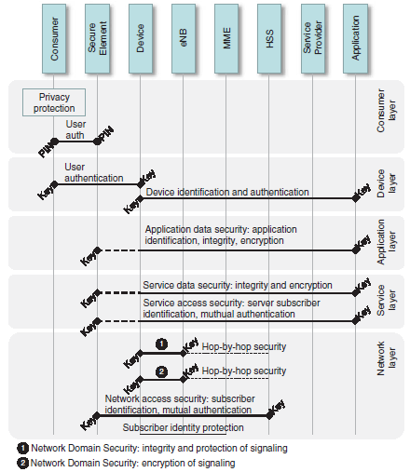
5G Security Layers
In addition to the different security configurations that may be introduced by the network operators by the means of network slices, the security requirements of other stakeholders need to be considered.
In order to reflect and address the requirements of those stakeholders and in order to separate them from the MNOs requirements during the discussion and definition of security solutions, SIMalliance has introduced a security layer concept as given in Fig below
Security layers as interpreted from SIM alliance.

Slide 25
5G Security Layers
The aspects that is not addressed in the figure are discussed below:
The device ID and key used for device identification may reside within the SE.
The SE could be used to also check the integrity of the device, e.g. by providing Trusted Platform Module (TPM) functionality on SE.
There could be several tunnels to different applications.
There could be multiple tunnels and keys showing that there could be multiple service providers.
Service layer integrity protection could be combined with identification and authentication.
The network layer is split into user and control plane where user plane (UP) integrity and encryption reach from the device to the service provider using a different session key. Note that Universal Mobile Telecommunications System (UMTS) and LTE do not include integrity protection of the UP data.
Some key derivation could be provided by the SE and the network entity to derive further, higher layer key material and security based on the operators’ key.

Slide 26
Device Security

Slide 27
Device Security
Differentiating the Devices
Depending on those use cases and the capabilities, the device can be associated with a device class based on its characteristics including spectrum (5G only or dual 4G/5G, single/multiband), number of applications, type of network (licensed or unlicensed, public, closed, fixed, wireless), type of access (direct or indirect), and type of credential (5G or non-5G).
Spectrum
Most devices are going to support multiple bands to support backward compatibility and roaming in countries, allocating a different spectrum than the home country. This means they will have to support several network authentication applications to access the respective network.
Number of Applications
Certain simple IoT devices and sensors may have one specific purpose and will consequently be provisioned with one specific application.
A vehicle may have to support autonomous driving as well as video streaming and data collection, thus representing use cases of all different building blocks as described above.
Type of Network
There are devices that support either access to licensed band or to both licensed and unlicensed band.
Other devices do only support access to unlicensed band.
A network may be public, i.e. widely deployed and accessible by many subscribers or closed (e.g. factory).

Slide 28
Device Security
Type of Access
Depending on the type of network, the device may be connected to the 5G network directly or via a relay device. In case the device does not support direct access, it may still hold 5G network credentials to authenticate to the 5G network when accessing it via the relay device.
Type of Credentials
Devices may support different types of credentials, depending on the type of access and type of network they support. In addition, devices that are used within public or closed networks and may need to support different types of credentials for each purpose.
Devices for Network Security
Devices are used to access and consume services. This can only be achieved if the devices are provisioned with a subscription that enables connection to the network. To connect, they need to be able to perform mutual authentication with the network. Today, this authentication is done based on the USIM residing on the UICC.

Slide 29
Device Security
Devices for Network Security (cont)
Let’s start with devices accessing closed networks. The assumption is that a factory or enterprise is operating its own 5G network. To grant employees access to the corporate network the factory may want to use its existing company ID system and thus replace the company ID card by the mobile device both for physical access and for access to in-company services and network resources.
To authenticate the user/device and the network, a certificate-based company ID system is used as authentication entity within and connected to the core of the closed 5G network. The device in this case needs to support the certificate-based authentication and needs to be provisioned with the respective credentials and certificates.
At the same time, the device should also be usable when the employee leaves the factory building and when the closed network does not provide coverage anymore. In this case, a handover to the public network of the network operator should take place based on credentials and authentication mechanisms owned and controlled by the network operator, as shown in Figure

Slide 30
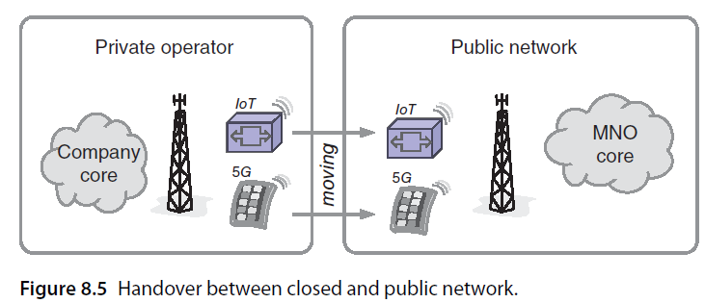
Device Security
Devices for Network Security (cont)
In addition, devices are supposed to connect to other devices without any connectivity to the public network.

Slide 31
Device Security
Devices for Network Security (cont)
The following security requirements can be derived from those different scenarios:
Group access. Authentication of groups of devices is required, in addition still each device may need to have its individual identifier to allow targeted management operations on that device. Group management of credentials and update of security capabilities is needed. Mechanisms defined for this purpose need to limit the impact on the network and signaling resources.
Direct access. Authenticated and authorized access to the network is needed. This is done based on network access credentials. There is a need to be able to manage those credentials.
Indirect access. The device connecting to the core need to be provisioned with network access credentials, however, as it does not have its own cellular connectivity it is using a relay device to transmit and authenticate with the core using its own network access credentials. Those are tunneled to the serving network via the relaying device. That relaying device may have its own credentials to establish a direct connection with the serving network.

Slide 32
Device Security
Device-to-Service and Device-to-Application Security
Today, several features are defined for the USIM that could be used to provide security also on the higher layers. Those features include the Generic Bootstrapping Architecture (GBA), that works to derive additional key material from the USIM.
That key material can be used to set up a unique and time-limited session key used to set up a secure TLS (Transport Layer Security) tunnel with the application server. Extensible Authentication Protocol, and Authentication and Key Agreement (EAP-AKA) as well as EAP-AKA’ are used to authenticate to non-3GPP networks such as WiFi.
Also, several other already-specified UICC mechanisms may be used to provide security on the upper layers. GSMA Association (GSMA) summarizes these USIM features with a focus on enhancing authentication to IoT services.
In current generations, the network operator is the owner of the UICC. If the network operator decides to offer additional services or applications, thus acts as service provider or application provider, the additional mechanisms could easily be enabled and used.
In 5G, the ownership model of the UICC continue to change. With technologies such as embedded UICC (embedded subscriber identity module, eSIM), the ownership model of the security component already changes.

Slide 33
Device Security
Device-to-Service and Device-to-Application Security (cont)
Specific security requirements include the following:
A generic security platform within the device must provide SW interfaces and APIs to applications.
Security platform shall be able to handle security configurations of multiple different and completely independent stakeholders.
Device shall be able to hold service subscriptions in addition to network access subscriptions and use those to authenticate to the service.

Slide 34
Device Security
Device-to-Device Security
In CriC, 5G devices will have to be able to directly communicate with other devices – as is the case with push-to-talk today. Police or fire brigades require to use radio in emergency areas even when there is no network coverage. The respective security requirements include:
Mutual authentication of a single or a group of devices – this involves keys need that to be negotiated and agreed.
Data must be encrypted and integrity protected.

Slide 35
Device Security
Device-to-User Security
The main security requirement to be fulfilled is that only authorized users shall be able to access the device. This can be achieved by verifying a PIN or biometric characteristic of the user. In addition, theft prevention should be considered, i.e. only authorized entities shall be able to disable or re-enable stolen devices.
Also, users may want to store and process private and confidential data on the device (e.g. photos) – applications leveraging the secure entity within the device could be used for this purpose.

Slide 36
Security between Network Entities

Slide 37
Security between Network Entities- i) Protection of the Mobile Edge
With MEC and virtualization, network functions and content are moving closer to the consumer. That means that NFs and content are replicated many times and are available in environments that are less protected than the network core. Edges need to retrieve an instance of the network function from the core
To make sure the edge is authorized to receive the NF instance or the content, authentication between the involved network entities need to take place.
In addition, the data being exchanged between those entities need to be protected at rest and in transit. This can be achieved by applying either software- or hardware-based security mechanisms.
Virtualization is a main concept in 5G so the assumption is that the security mechanisms in the edges will also be based on virtualization technologies involving hypervisors and isolation.

Slide 38
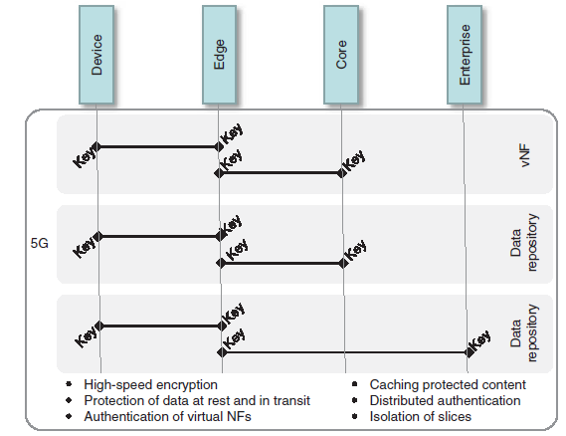
Security between Network Entities- i) Protection of the Mobile Edge

Slide 39
ii) Authentication Framework
To support fixed and wireless networks as well as licensed and unlicensed, public and closed networks, and several different network slices, a flexible and scalable authentication framework is required both on the device and the network infrastructure. This implies that several authentication mechanisms need to be supported on the device as well as by the respective network entities

Slide 40
5G Security Architecture for 3GPP Networks

Slide 41
5G Security Architecture for 3GPP Networks
Network Security Functions and Elements
The 3GPP 5G system consists of evolved physical radio and core networks and their logical functions. The security architecture can be presented as security domains that consist of application stratum, home and serving stratum, and transport stratum.

Slide 42
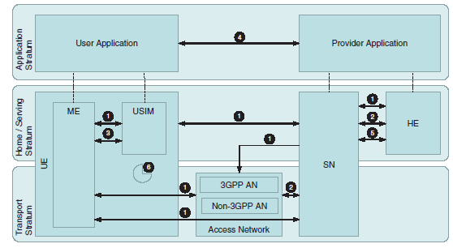
Security architecture interfaces

Slide 43
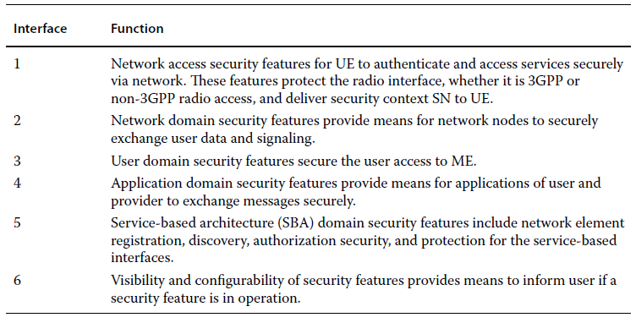
Security architecture interfaces

Slide 44
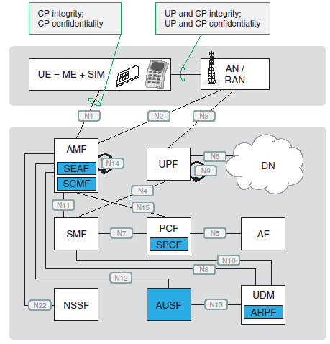
The 5G security architecture for non-roaming scenario

Slide 45
The 5G security architecture for non-roaming scenario
The 5G functional elements involved in the signaling between the UE and network are
SEAF (Security Anchor Function)
AUSF (Authentication Server Function)
UDM(Unified Data Management)
ARPF (Authentication credential Repository and Processing Function)
SIDF (Subscription Identifier De-Concealing Function)

Slide 46
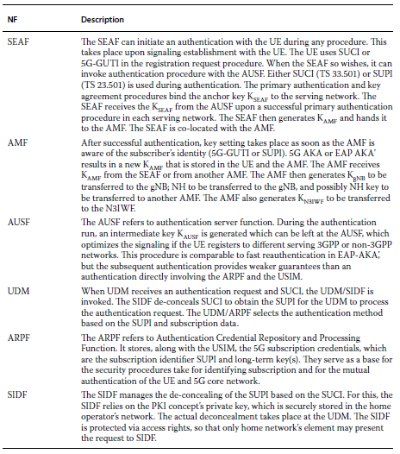
The 5G security architecture for non-roaming scenario

Slide 47
Key Hierarchy
The 5G system has a key hierarchy as depicted in Figure, defined by the 3GPP. The defined key lengths are by default 128 bits in the initial phase of the 5G networks, and the network interfaces shall be prepared to support key lengths of 256 bits in the future.
KgNB* is one of these, derived by Mobile Equipment (ME) and 5G NodeB (gNB) in the derivation of horizontal or vertical key, using Key Derivation Function (KDF).
Another one is K′ AMF which is derived by AMF and ME when the UE moves from one AMF to another during inter-AMF mobility, using KDF. Also, for the case of dual connectivity there is a key derived. This happens in such a way that when the master node (MN) establishes security context first time between slave node (SN) and the device (UE) for a access stratum (AS) security context, the MN forms an S-KSN and delivers it to the SN over the Xn-C interface.
The MN forms the S-KSN by associating a Secondary Cell Group (SCG) counter along with the AS security context. The MN sends the SCG counter value to the UE via Radio Resource Control (RRC), signaling the UE needs to generate a new S-KSN.

Slide 48
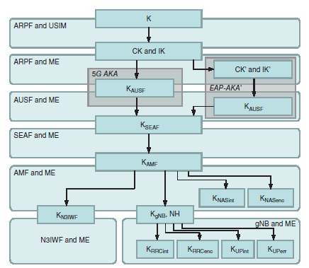
Key Hierarchy

Slide 49
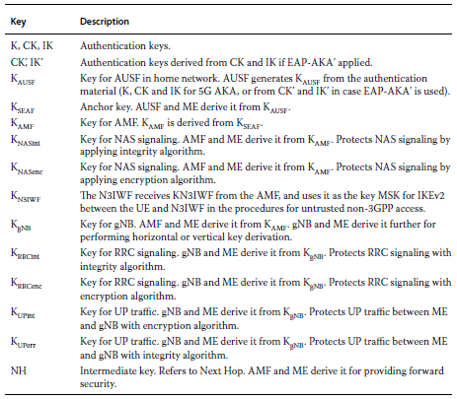
The 5G keys

Slide 50
UICC Evolution

Slide 51
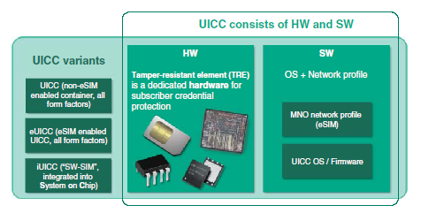
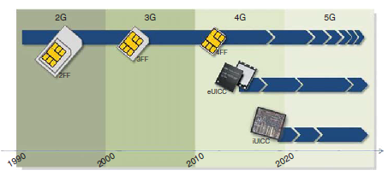
UICC Evolution
UICC variants
UICC Timelines

Slide 52
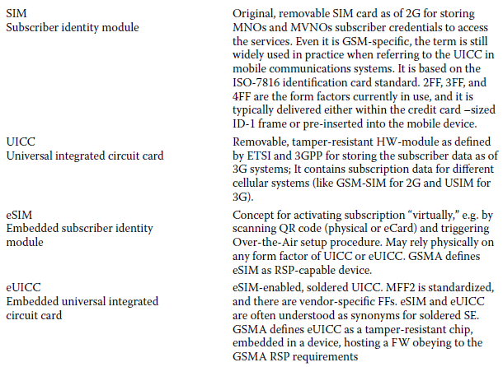
Key terminology related to the mobile subscription

Slide 53
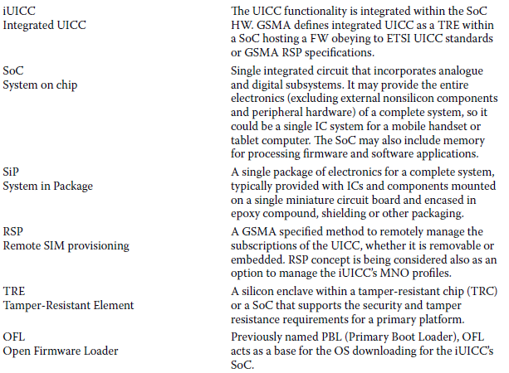
Key terminology related to the mobile subscription

Slide 54
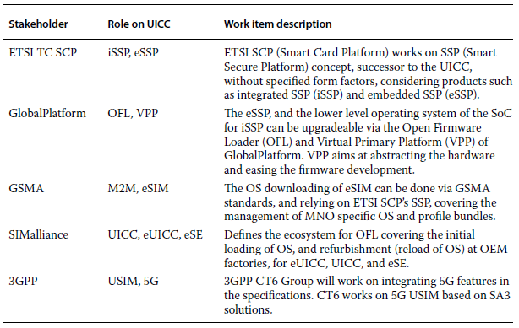
Standardization of UICC evolution

Slide 55
The UICC in the 5G Era
The “traditional” UICC will maintain its relevance as a tamper-resistant, hardware based, secure element to securely store keys and other confidential information. There is an extensive legacy device base and established ecosystem, which has been formalized for the manufacturing, logistics, and personalization of the MNO profiles. The UICC provides an adequate security level compliant with strict international accreditation requirements as dictated by the GSMA SAS and payment institutions.
With rapid developments in the IoT and the need for built-in security for IoT devices, the market will benefit from a deeper integration of the USIM functionality into these devices. An ultra-small device would not be able to house a traditional UICC form factor due to its physical size. Thus, increasingly tiny form factors of the UICCs are expected to arrive on the 5G markets, including a variety of both embedded UICCs and integrated UICCs.
Also additional UICC variants are expected in the 5G era along with the previous form factors – which are still worthwhile in the established ecosystems and provisioning techniques. For the embedded and integrated UICC variants, standardization defines their management via the interoperable eSIM concept.

Slide 56
The UICC in the 5G Era (Cont)
The new interoperable variants of the UICC are facilitated by ETSI, which has widened the traditional definition of a UICC. At the same time, the terminology now reflects an improved generic form, and, as a result, ETSI refers to the evolution of UICC by the new term SSP. It should be noted that SSP is not equivalent to UICC, and UICC still continues to exist.
For both the embedded form of the UICC and the integrated variant, referred to as eSSP and iSSP, respectively, per new ETSI terminology, the management of the respective
MNO profiles and subscription data can be based on the GSMA eSIM concept and supported by the ecosystem developed by Global Platform and SIM alliance.
As has been the principle in 3GPP releases, backward compatibility is essential and will continue to be with the new variants so the impacts of 5G on the original UICCs are expected to be minimal.
There will be 5G-specific files included in the new UICCs as of Release 15. Nevertheless, the 5G file structure remains the same as in previous versions of the USIM. In addition, the pre-existing UICC form factors are still valid, referring to the standardized 2FF, 3FF, 4FF, as well as to the MFF2 used in M2M applications.

Slide 57
UICC Profiles in 5G
3GPP defines the 5G subscription credentials as a set of values in the USIM and the ARPF. 5G subscription credentials consist of long-term key or set of keys K, unique for each user, and the SUPI (Subscriber Permanent Identity), which uniquely identifies a subscription. The K and SUPI function for mutually authenticate the UE with the 5G core network.
The subscription credentials are processed and stored in the USIM. In addition, 3GPP has confirmed the USIM still resides on a UICC in the 5G era.
The 3GPP technical specification TS 31.103 outlines the features of the IP Multimedia Services Identity Module (ISIM) application. In Release 15, there is one new file defined in this specification with a configuration parameter for handover between WLAN and EPS. There is also an updated file ID for EF-XCAP ConfigData (IP Multimedia Subsystem [IMS] configuration file) in the ISIM, to match the value used in the USIM.

Slide 58
Changes in Authentication
Changes in format of new profile files and a few modifications with the aim to maintain UICC compatibility.
The UICC may be removable or non removable. The ETSI SCP is working on a new secure element referred to as SSP. The SSP can be included conditionally as another solution on which the USIM can reside, but only if the SSP is defined in the Release 15 time frame, and if it complies with the security requirements defined in the present specifications.
For non-3GPP access networks, USIM applies in the case of a terminal with 3GPP access capabilities. If the terminal supports 3GPP access capabilities, the credentials used with EAP-AKA and 5G AKA for non-3GPP access networks shall reside on the UICC.

Slide 59
5G UICC Security
The principles designed for managing the UICCs, as defined via the eSIM construct (formerly known as RSP (Remote SIM provision) of GSMA), will also apply in 5G. The evolution of 5G subscription management includes the convergence to support consumer and M2M devices via a common platform which is still under development.
The evolution of the UICC toward embedded and integrated variants needs to be considered when designing the proper security as the iUICC security solution necessarily changes established workflows. As International Telecommunications Union (ITU) IMT-2020 dictates, the level of the 5G security shall be at least the same or better than in previous telecommunications systems.
The integrated UICC provides deeper physical integration into the SoC, making security breaches, such as local side channel attacks, even more difficult to execute.
Concurrently however, there may be unknown, potential security weaknesses opened due to the new technology, especially regarding the intercommunication between the shielded and secured area and external electronics, such as NVM. Hence, there is a need to protect the solution via up-to-date accreditation schemes.

Slide 60
Legacy UICC Compatibility with 5G
The 3GPP states that it is expected that the UE might be able to access the 5G system with the existing UICCs that are found already in commercial market. It is thus possible that the UE will camp on a 5G system even if the UICC is not able to recognize the new network. As the 3GPP specifications aim to provide a good level of backward compatibility in general, it is important to ensure the functionality of this scenario by updating the specifications where appropriate and feasible.
In practice, to handle this scenario, a new bit is required in the USIM Service Table to indicate the support for the 5G system so that the ME can adjust its behavior depending on the UICC support. Furthermore, a new bit is needed in the Terminal Profile to provide the ME with possibility to inform the UICC of the 5G support.
The fields are:
Access Technology
Location Information
Timing Advance
Network Measurement Results
Network Rejection Event
Bearer Independent Protocol
Call Control on Packet Data Unit (PDU) Connection Establishment by USIM
Data Connection Status Change Event
Launch Browser

Slide 61
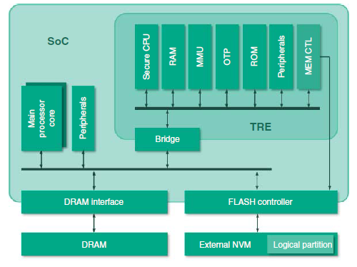
iUICC Components
The iUICC HW refers to a tamper-resistant enclave on a SoC, based on separate security controller. This concept is designed to replicate the functions of the UICC in such a way that no separate component – “traditional” SIM forms or embedded SIMs – are needed due to the integrated functions in the SoC itself.
Based on the service organization control (SOC), it is possible to deploy default safety mechanisms, such as Tamper-Resistant Element (TRE) counter, against rollback attacks

Slide 62
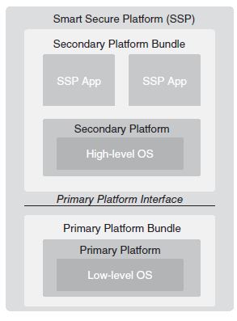
The SSP concept as defined by ETSI

Slide 63
Vehicle Communications

Slide 64
Vehicle Communications
One of the pillars for 5G is vehicle communications. In fact, 5G provides a logical platform for large areas, and thus, the V2X served by 5G offers optimized methods to tackle the communications between the vehicles and rest of the infrastructure.
The cooperative intelligent transportations system (ITS) and car-2-car communication is based on the IEEE 802.11p WLAN at 5.9 GHz in Europe and in the United States. When two or more vehicles (ITS stations) appear within the radio communication range, they connect automatically and establish an ad-hoc network where all ITS stations know the position, speed, and direction of the other stations and will be able to provide warnings and information to each other.
A single WLAN link is limited to about 1000 ft, or a few hundred meters. Each vehicle also works as a router and may deliver messages via multiple hops to other vehicles and ITS stations. The routing is adaptive and can cope with fast changes within the ad-hoc network topology.
Drivers benefit from Cooperative Intelligent Transport System (C-ITS) support, e.g. when approaching the end of a traffic jam, if a vehicle in front suddenly brakes hard, and if a broken-down vehicle or road construction blocks the route. Applications of V2V include forward collision warning, blind spot warning and lane change warning, emergency brake light warning, control loss warning, and no pass warning.
How V2V Works

Slide 65
V2V System Overview
A V2V communication system comprises three distinct domains: in-vehicle; ad-hoc; and infrastructure domain.
i) In-Vehicle
Thein-vehicle domain refers to a network logically composed of an on-board unit (OBU) and application units (AU). The AU refers to a dedicated device that executes a single or a set of applications and utilizes the OBU communication capabilities.
The AU can be an integrated part of a vehicle and can be permanently connected to the OBU. It can also be a portable device such as a laptop that can dynamically attach to the OBU. The AU and OBU are typically connected via wire, but the connection can also be wireless, such as Bluetooth.
ii) Ad-hoc
The ad-hoc domain, or vehicular ad-hoc network (VANET), is composed of vehicles equipped with OBUs and stationary units along the road, i.e. roadside units (RSUs). The OBU is equipped with a short-range wireless communication device dedicated for road safety, and potentially with other optional communication devices.
The OBUs form a mobile ad-hoc network (MANET) for communications among nodes in a distributed manner without the need for centralized coordination instance.

Slide 66
V2V System Overview (contd)
iii) Infrastructure
While RSUs for Internet access are typically set up with a controlled process by a Car-to-Car Communication Consortium (C2C CC) key stakeholder (such as road administrator), public or privately owned hot spots (HSs) are usually set up in a less-controlled environment. These two types of infrastructure domain access, RSU and HS, also correspond to different applications types.
If neither RSUs nor HSs provide Internet access, OBUs may utilize communication capabilities of cellular radio networks (2G, 3G, 4G, 5G) if they are integrated in the OBU.
The infrastructure domain is linked to a public key infrastructure (PKI) certification infrastructure. The certification authority (CA) issues digital certificates to OBUs and RSUs.
Please note that some sources interpret vehicle-to-roadside (V2R) as its own communication domain (representing a special case of V2I).

Slide 67
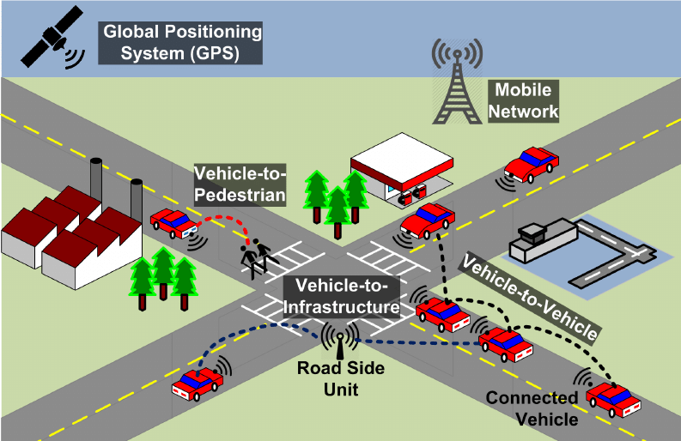
V2V System

Slide 68
V2V Reference Architecture
The “traditional” architecture of V2X is based on IEEE 802.11p connectivity. ITS America supports the US Department of Transportation’s (USDOT) connected vehicle program that is focused on the use of dedicated short-range communications (DSRC)/wireless access in vehicular environments (WAVE). USDOT has constructed a pilot to demonstrate effectiveness of DSRC with a mix of light, heavy, and transit vehicles.
Nevertheless, cellular-based, and especially 3GPP LTE-based connectivity is becoming more feasible for the local vehicle communications, too, along with the further standardization of, e.g. direct communications between the user devices.
5GAA (5G Automotive Association) is a rather new initiative to drive for the cellular connectivity in V2X environment. The forum represents the automotive industry, and there are also many other companies as members, including Verizon and Gemalto.

Slide 69
Development of V2X
V2X evolves and will include enhanced concepts in Advanced Driver Assistance Systems (ADASs). ADAS refers to a system that provides means for vehicles to cooperate, coordinate, and share sensed information. V2X will grow into Connected and Automated Driving (CAD).
As soon as 5G networks and corresponding reliable, low-latency, and mission-critical services are available for V2X applications, ADAS and CAD can be enhanced further.
V2V communication market size was at more than USD15 billion in 2015 and is likely to grow at an estimated annual rate of more than 5% by 2023. Connected vehicles may generate significant data, which brings new market potential for the data owner. It also can be assumed that the developing ecosystem provides new business opportunities to the involved and to third parties.

Slide 70
Security
V2V security design benefits from advanced OTA capabilities in cooperation with intelligent methods protecting against threats in order to ensure both occupant safety and vehicular serviceability.
In North America, the USDOT National Highway Traffic Safety Administration (NHTSA) has issued a Notice of Proposed Rulemaking (NPRM) to mandate vehicle-to-vehicle communication technology for new light vehicles in the United States.

Slide 71
NHTSA Requirements
The NHTSA is proposing to issue a new Federal Motor Vehicle Safety Standard (FMVSS) No. 150, to require all new light vehicles to be capable of V2V communications, such that they will send and receive basic safety messages (BSMs) to and from other vehicles.
The document detailing the rules is “NHTSA 49 CFR Part 571, Docket No. NHTSA-2016-0126, RIN 2127-AL55, FMVSS; V2V Communications.”
The proposal contains V2V communication performance requirements predicated on the use of on-board DSRC (Dedicated Short Range Communications) devices to transmit BSMs (Basic Safety Messages) about a vehicle’s speed, heading, brake status, and other vehicle information to surrounding vehicles, and receive the same information from them. This would help vehicle systems identify potential crash situations with other vehicles and warn their drivers.

Slide 72
IEEE 802.11p vs. LTE-Based Short-Range Comm.
The V2X communications has been “traditionally” based on the IEEE 802.11p connectivity in such a way that the vehicles as well as the roadside elements automatically establish the data transmission in an ad-hoc network. As the 3GPP LTE standards are evolving, they also start including functionalities that can be utilized in vehicle communications, such as direct connection between the user equipment.
5GAA is driving for the cellular variant to be included in the V2X. 5GAA is emphasizing the enhanced performance of the LTE-based dedicate short-range communications over not-so-optimal IEEE variant. As an example, C-V2X (cellular vehicle-to-everything) is straightforward via the LTE itself while the WLAN requires hot spots in surrounding areas to connect beyond the direct data transmission between vehicles

Slide 73
IEEE 802.11p vs. LTE-Based Short-Range Communications (cont)
Benefits of C-V2X over IEEE 802.11p include:
Synchronous vs. asynchronous enhances spectral efficiency as it enables time division multiplexing and lowers channel access overhead.
Frequency Division Multiplexing (FDM) and Time Division Multiplexing (TDM) vs. solely TDM optimizes radio link budget and thus cell range.
Turbo coding vs. convolutional coding provides a gain of approximately 3 dB, which benefits the radio link budget.
HARQ (Hybrid Automatic Repeat and Request) vs. no HARQ further enhances the cell range.
Single-Carrier Frequency Division Multiplex (SC-FDM) vs. Orthogonal Frequency Division Multiplexing (OFDM) optimizes the power amplifier’s transmission power.
Semi-persistent transmission and relative energy-based selection vs. CSMA-CA (Carrier Sense Multiple Access and Collision Avoidance) optimizes the resource selection.

Slide 74
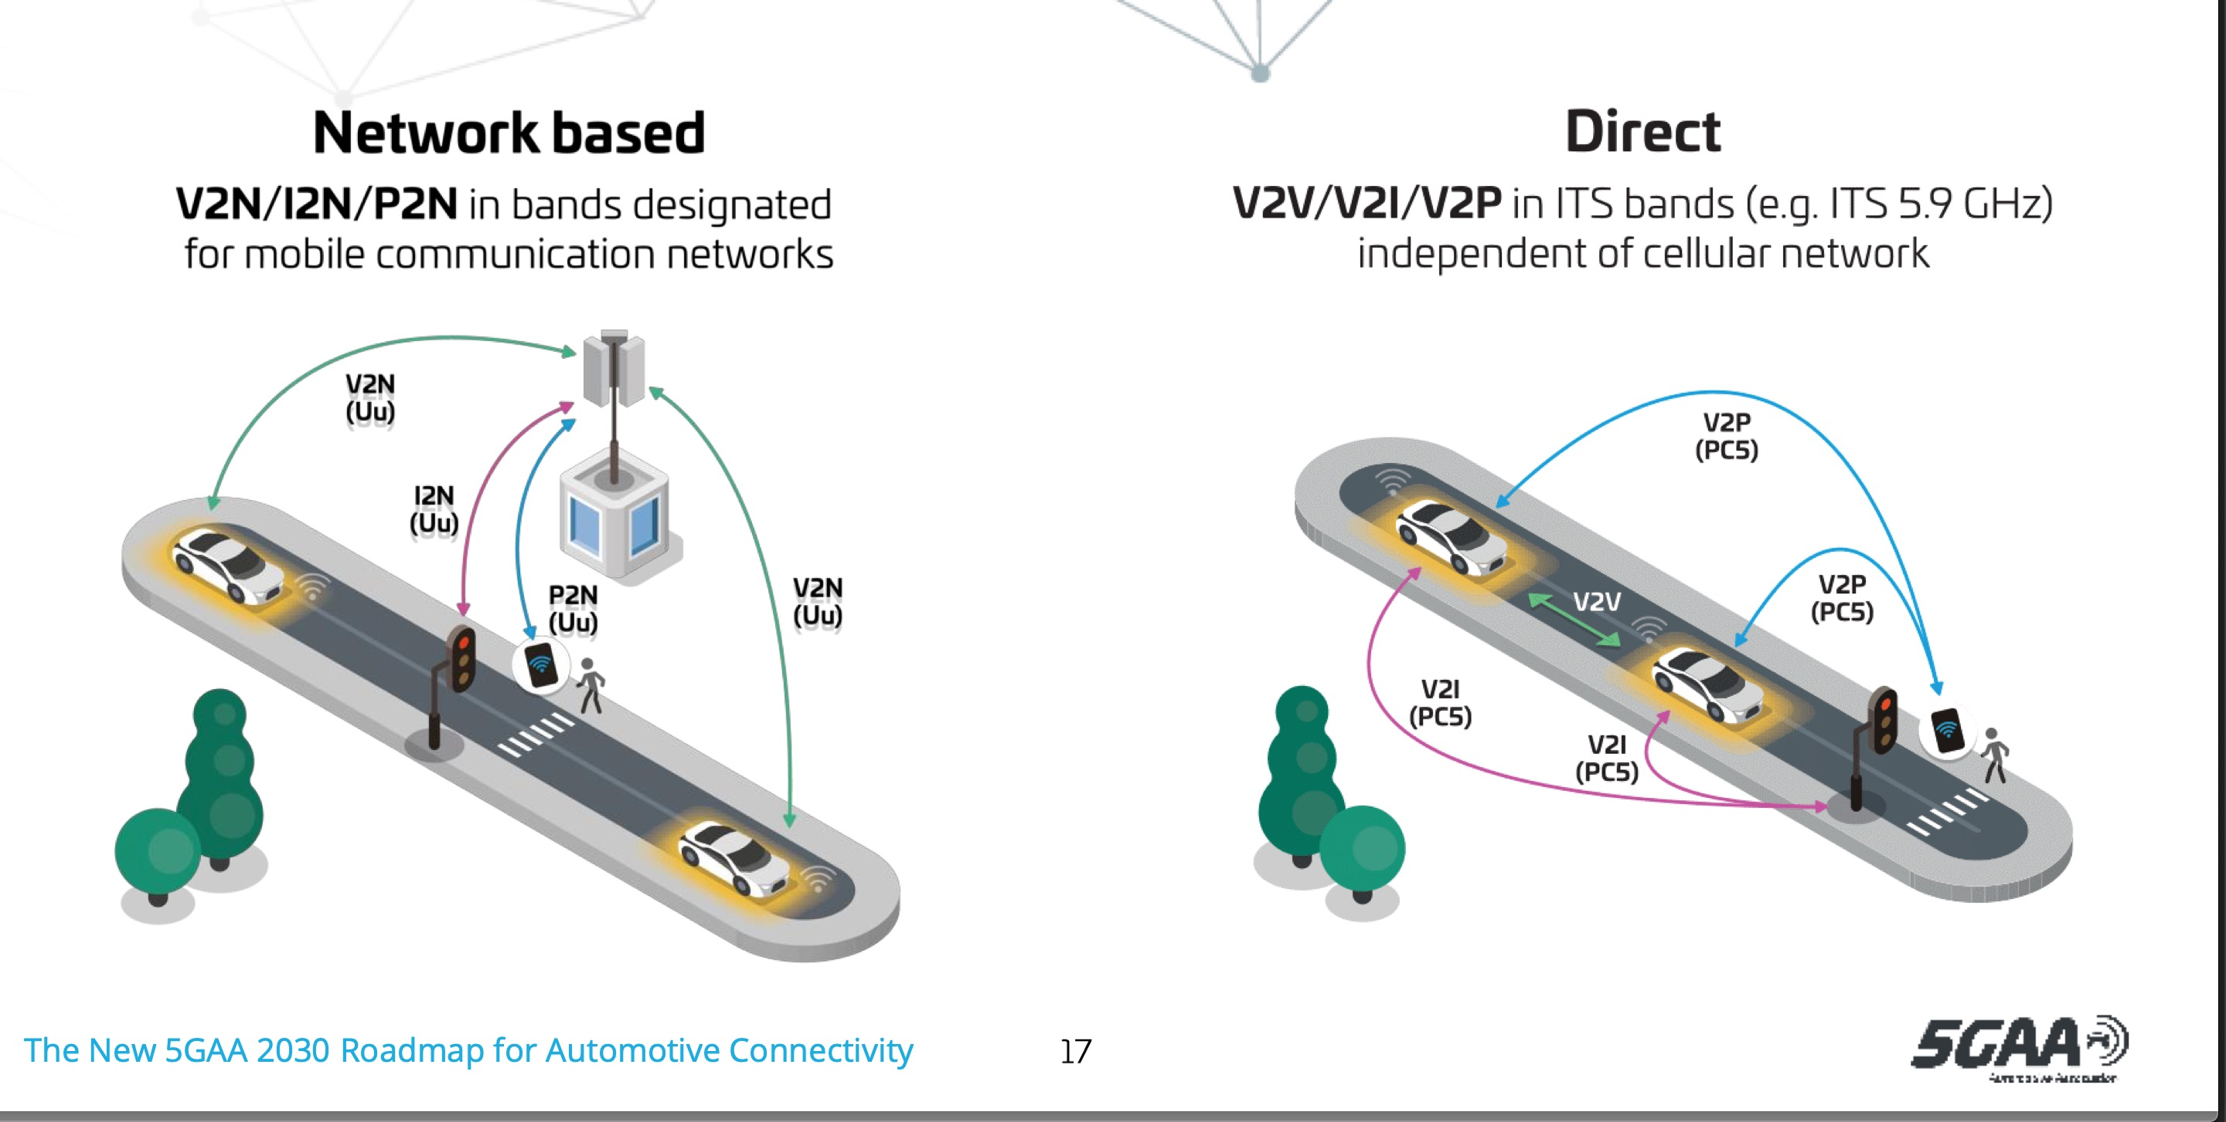
5GAA Roadmap

Slide 75
Security Threats
As some examples, potential attacker can intend to jailbreak a V2V communication system to send arbitrary messages to other vehicle, including false alarms to drivers. There could thus be messages that exploit the car system to access the physical capabilities of the V2V system. The BSM is the primary message set proposed to send data between vehicles and between vehicles and the infrastructure.
Although the BSM is mainly developed for safety applications, it may also be used by other connected vehicle applications, such as mobility, weather, and AERIS (Applications for the Environment: Real-Time Information Synthesis) programs, delivering safety benefits, too. Currently, USDOT is developing the applications. The assurance of the secure communication of these messages is essential. Also, as for congestion, it is critical that safety messaging not be compromised due to broadcasting more data for V2I.

Slide 76
MNO Role in V2V
One of the main roles of MNO in V2V business is the ability to control V2V communication, which refers to the ability of MNO to perform authorization, session establishment, and resource allocation. Furthermore, the RSU entity can be implemented either in an evolved NodeB (eNodeB) or a stationary UE. Standardization work has been active across 3GPP.The supporting LTE-based technology is suitable for V2X services and will further evolve for future V2X. The new cellular network assisted LTE-D2D provides a logical business opportunity for all C-ITS stakeholders.
The 5GAA has taken the role of driving the technology adaptation in a form of an industry forum. It is beneficial to promote the cellular-based technology among car makers, MNOs, road operators, authorities, for standard, spectrum, deployment, and business model definition. To date, USDOT has been reluctant to consider cellular-based telematics because of concerns that cellular carriers will not commit to a single technology (2G, 3G, or 4G consistently nationwide etc.) over a long period of time, forcing car owners and state DOTs to constantly upgrade equipment in vehicles and intersections, respectively.
Telematics service providers, infrastructure ITS services (e.g. tolling), M2M, and other application service providers are thus waiting for more information to commit to correct technology. Road operators and vehicle manufacturers need to examine future WAN services critically, based on assessment of their potential longevity and their cost, service quality, and coverage.

Slide 77
Machine Learning and Artificial Intelligence

Slide 78
Machine Learning and Artificial Intelligence
As 5G takes off, concrete steps can be taken in the development of artificial intelligence (AI), which can assist in many areas on top of 5G services.
It can be generalized that the evolution along with 5G deployments are moving the “traditional” models, relying on autonomic network management to cognitive network management.
The transition includes machine-learning abilities combined with self-aware, self-configuring, self-optimizing, self-healing, and self-protecting networks.

Slide 79
THANK YOU

